Slide 1
Java SE 17 – Presentation
Chapter 10 – Streams

Slide 2
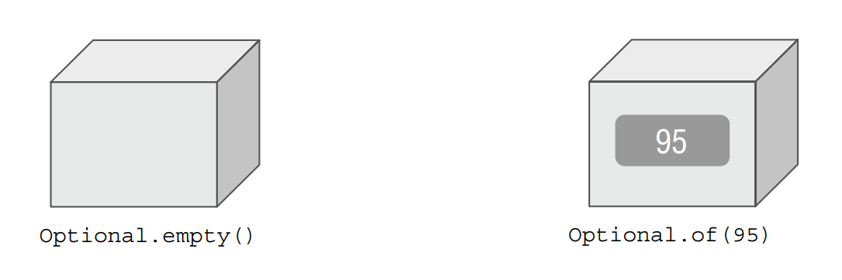
Chapter 10 – Streams
Returning An Optional
- In Java, there are many ways to ...non ... values such as ..., ...,etc
- But there is a safer and ... way to ..., which is ...<T>
- For example, a student is studying ... class and has ... grade => ...
– But if this student change ... => ... grade => ... => How can we ... ? => We use Optional<T>
- Optional<T> can be created by ...

Slide 3
Chapter 10 – Streams
- We can imagine Optional as ... If the value ... => ..., otherwise, ....
Creating an Optional
(code illustration snippet 1)
- When using ..., we usually check if ... value ...
(code illustration snippet 2)
- If we try to ... => We will get
(code illustration snippet 3)
- When working with ...., we usually assign ... for .... value. We can check if ... using ... or ... operator. Since this code is ... => Java has to ...
(code illustration 4,5)

Slide 4
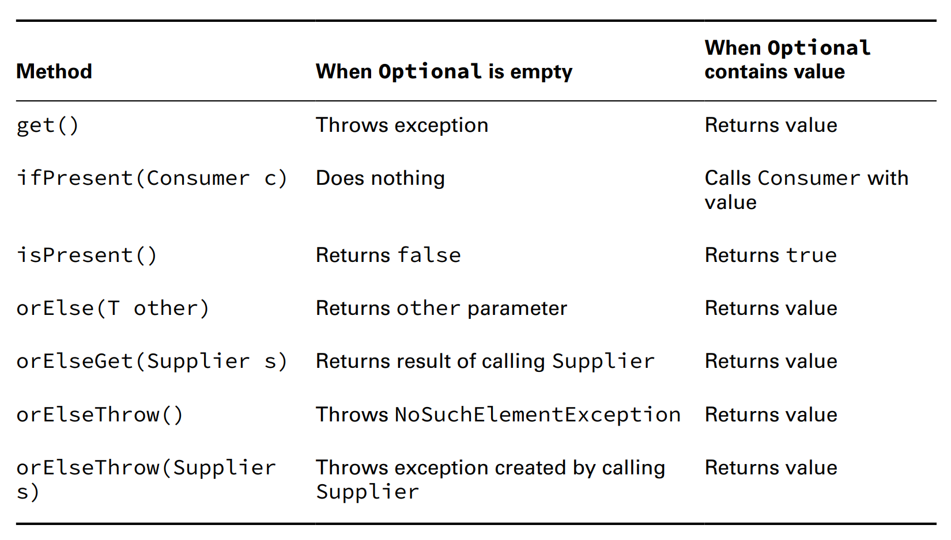


Chapter 10 – Streams

Slide 5
Chapter 10 – Streams
(code illustration snippet 6)
Dealing with an Empty Optional
(code illustration snippet 7,8,9,10,11)
- An alternating method to ... is returning ... for ... value. We have mentioned about this ... since Optional<T> is better than ... since we don't know the return of ... indicate ...
– Another advantage of ... is ... implementing functional ... into ... instead of using traditional ...
– In the last ..., we will know that we can use method ... for Optional
Using Streams
- Stream in Java is ... a ... data
- Stream ... is ... ...return results
Understanding the Pipeline flow
- Let's think Stream Pipeline as ... line. Let's take sign production as an example
– In a sign ..., there are 3 ..., 1 for ..., 1 for ..., 1 for ...
– Notice that this line is ... ( ... <-> ...)
– This assembly line is ..., this means that once the line reach ... => ...
– Finite stream is the same, ...

Slide 6
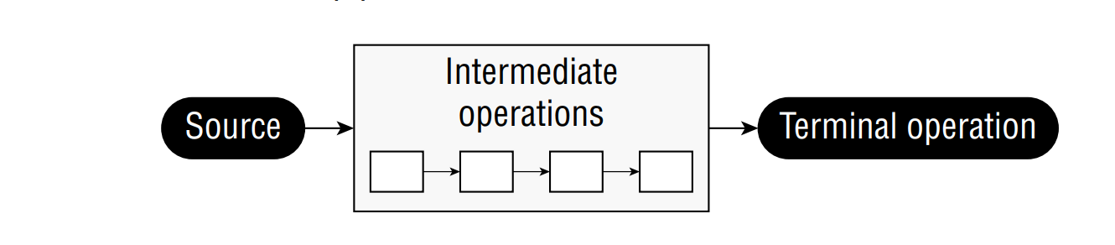
Chapter 10 – Streams
- There are some examples of infinite ... such as food ... (where it will be ... if ...), or Sun ... (it goes ... until ...)
- Another characteristic of ... line is that each ... do their own ... => Once finished, ...
- This is different than .../... that we studied. ... differs from ... because of how we ... them, but all ... are still there
– With stream, the data ..., it is generated ... => We call this ..., this means delay the ... until ...
- There are so many ... can happen in a ... line => In FP, these are called Stream ...
- Just like ... line, all ... happens in a pipeline, there will be 1 ... and 1 ... and can be n ...
- There are 3 main parts in a ...
+)
+)
+) (note that all ... only run when ...)

Slide 7
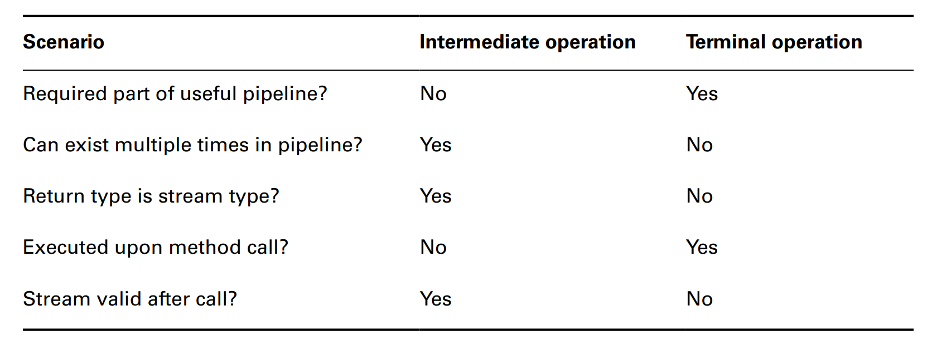






Chapter 10 – Streams

Slide 8
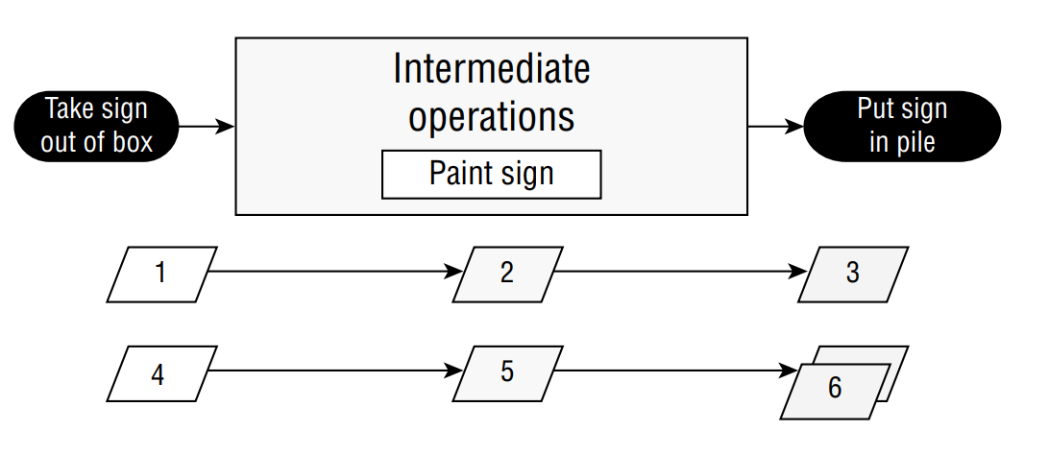
Chapter 10 – Streams
- In a ... line, there is a person called ... who manage .... In Stream, Java ...
- This is a crucial ..., especially in processing lazy ... and ... stream
- Imagine Stream is just like giving ... to ... When ... done, ... will setup ..., assign ..., and inform ....
- However, the workers can only ... once the ... start ...
– The foreperson will start ... once he see the .... He also manage the ... and ... the line once the ...

Slide 9
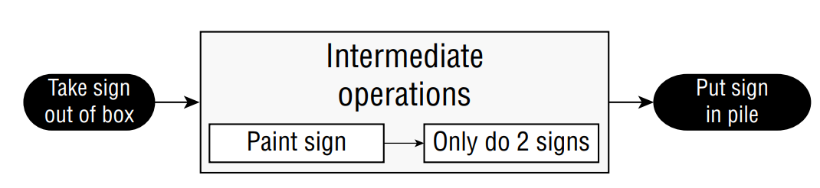
Chapter 10 – Streams
- From ... perspective (the sign production example), he sees that we must ... first => He set ...
– Next, he sees that we ... => He set ... and set ... for
- Finally, he sees that ... => He set ... and begin to ...
- For the last figure, we have ... only => after we reach ..., the ... order to ...
- This is another example of another .... The difference is that once we ..., the ... will ...

Slide 10
Chapter 10 – Streams
Creating Stream Sources
- In Java, the Stream we said is ... in package ...
Creating Finite Stream
- Now we will begin with simple ...
(code illustration snippet 12)
- We can convert ... to ...
(code illustration snippet 13)
- We can also create ... special ... called ...
(code illustration snippet 14)
- ParallelStream is related to ... topic. Imagine it looks like multiple ... same. For example, the sign ..., it looks like multiple ... => It will be ... than ...
– However, there are some tasks that aren't ... such as ... original order ...
– Moreover, some tasks ... faster than ...
- We will study more about this on chapter 13
Creating Infinite Stream

Slide 11
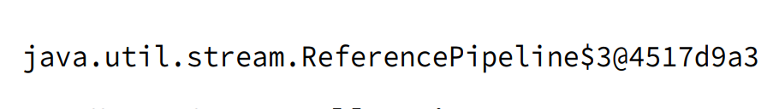
Chapter 10 – Streams
- We can see that there are some cases that look like ... However, there are some cases where ... not look like ... => We have ...stream to ...
(code illustration snippet 15)
- If we ... forEach(), it will ... until ...
– Moreover, we can convert ... back to ... using method ...
– The ... method recieves 2 parameters (1 is for ... (also called ...) , 1 is for ...). This method will ... until ...
- ... iterate() also has another ... which receives ... and it is used to ...
(code illustration snippet 16)
Reviewing Stream Creation Methods

Slide 12
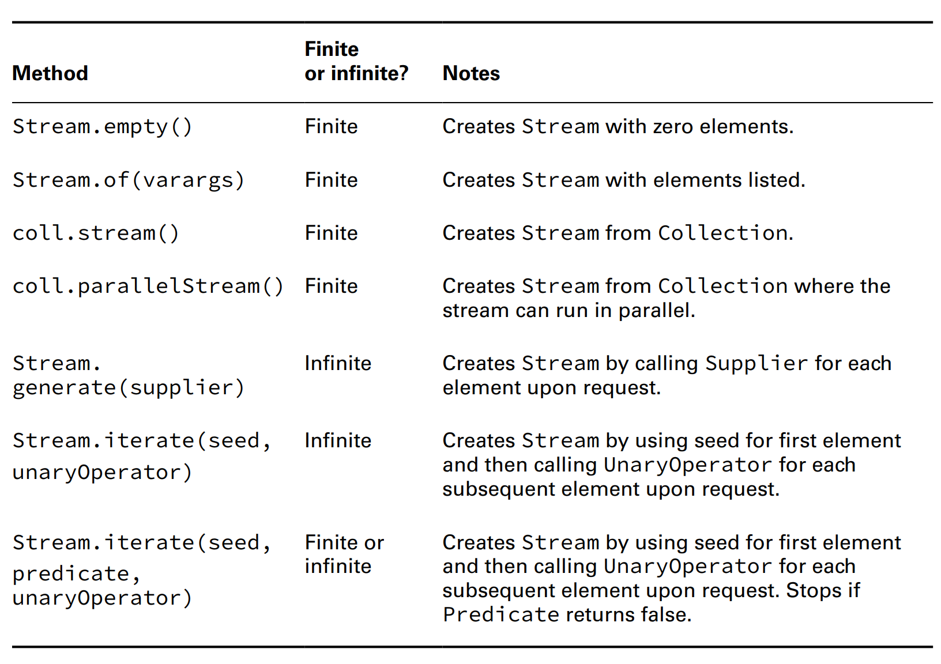
Chapter 10 – Streams

Slide 13
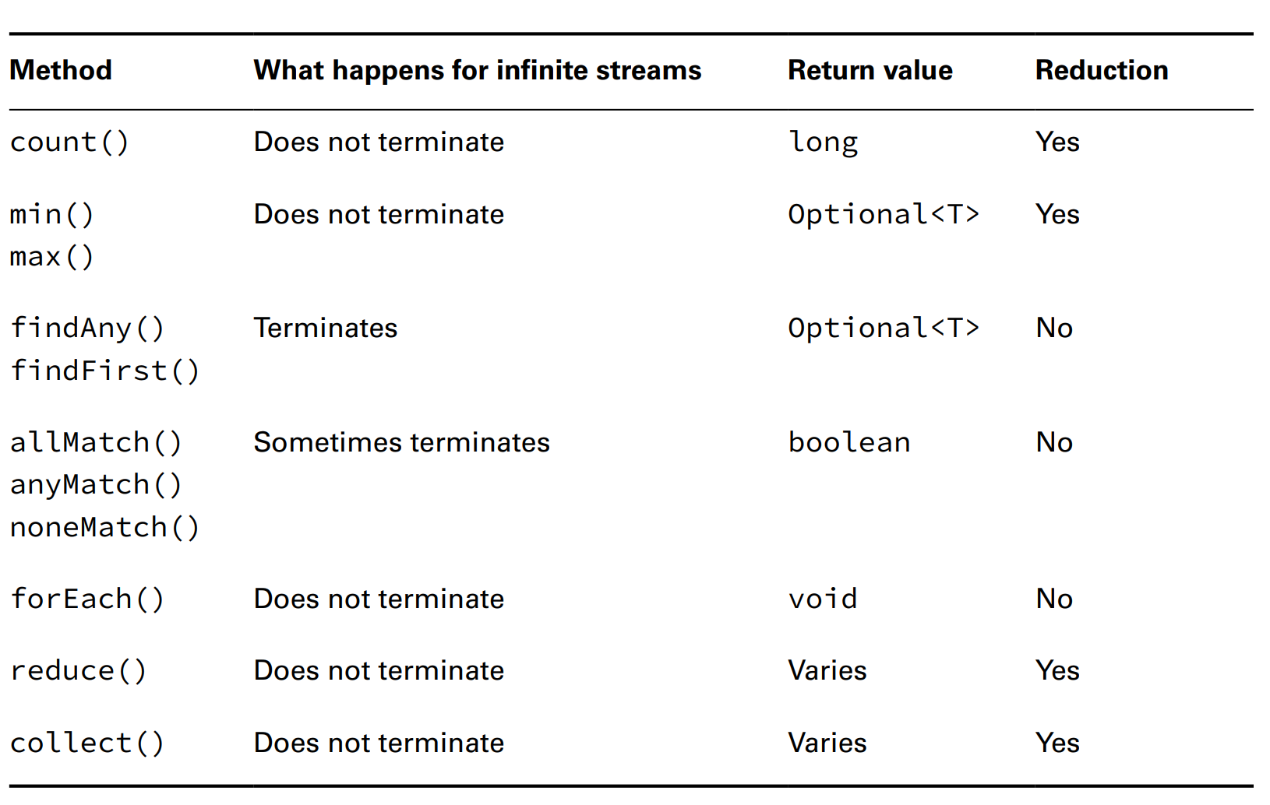
Chapter 10 – Streams
Using Common Terminal Operations
- Because ... ops will only ... once Java ..., so we will talk about it first
- ... is a special type of ... operations since it condense ... into ... or ...

Slide 14

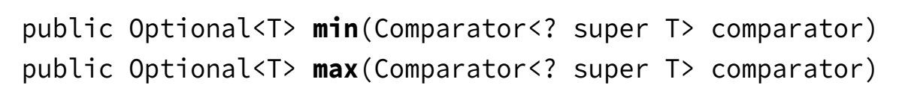
Chapter 10 – Streams
Counting
- The method ... will count ... in ... However, it will run ... in a ...
(code illustration snippet 17)
Finding the minimum and maximum
- 2 methods ... and ... will allow us to pass ... However, if we run ... 2 in a ... it will run ... because ...
(code illustration snippet 18, 19)
- We won't be able to get both ... because this is ... op => Stream won't be ...
- Later in the chapter, we will know that there exist some methods that ...

Slide 15
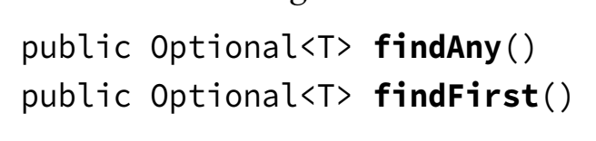
Chapter 10 – Streams
Finding a Value
- The method findFirst() will always ... if ... (obviously it will return ... if ...). In some cases where stream is ... findFirst() will ... random ... (such cases is Hash...)
- The method findAny() will always ... element ... best ... (if ... order, then ..., otherwise ... but still have best ...)
- These 2 methods are ... op because they aren't ...
(code illustration snippet 20)

Slide 16
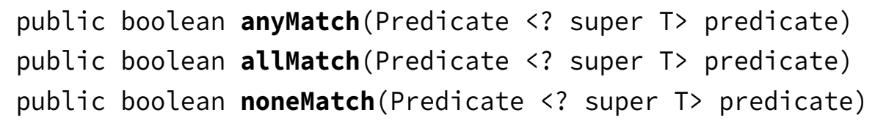
Chapter 10 – Streams
Matching
- ... anyMatch() ... if only 1 ...
- ... noneMatch() ... if all ...
– ... allMatch() ... if all ..
- All 3 methods aren't ... op because they aren't ...
(code illustration snippet 21)
- For infinite stream, if ... or ... then ..., ... otherwise, ...
Iterating
- In Java ..., iterations ... Obviously if we ... forEach() on ..., it won't ...
- However, before using ... we must consider ... (for example, for with if can be ... filter(), later in the chapter)

Slide 17
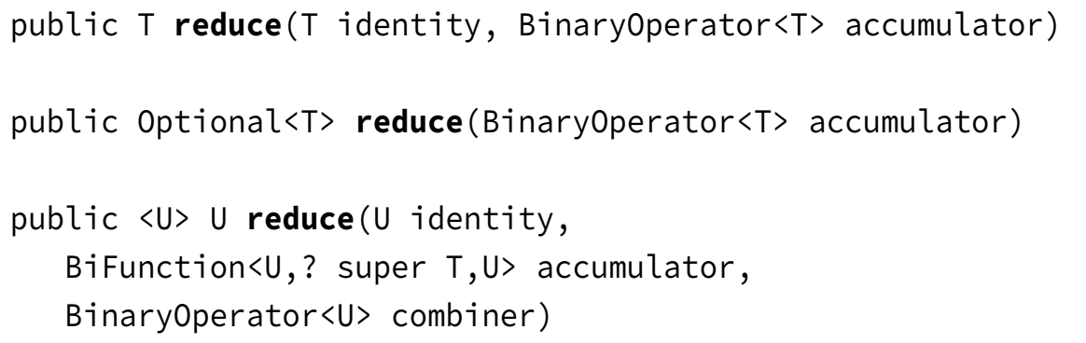
Chapter 10 – Streams
(code illustration snippet 22)
- Don't be confused with ... in ... and ... in ...
– Stream can't use traditional ... because ...
(code illustration snippet 23)
Reducing
- The method ... will reduce the whole ... into a single ... This is a ... operation because it process all ...

Slide 18
Chapter 10 – Streams
- The most common way of ... is to start with a initial ...and ... with the next ...
(code illustration snippet 24)
- Identity is ..., accu ... is ...
(code illustration snippet 25, 26, 27)
- If the method doesnt have ..., then it will return ... because ...
- There are 3 cases for ...
+)
+)
+)
(code illustration snippet 28)
- If we have only 1 ... method and it always requires ... Then we are assuming .... => ...
- A 3rd type of ... method ... This method is used to handle different ... by creating an ... and combine ...
(code illustration snippet 29)
- This type of reduce() is helpful for ... stream ... because ... mutiple ... can ... and ...

Slide 19
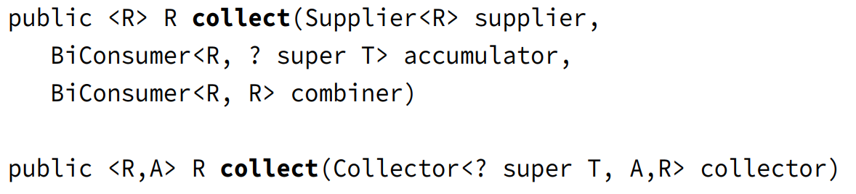
Chapter 10 – Streams
Collecting
- collect() is a special ... and it is called as .... reduction
– This is different from ... because it use ... object to ...
- Some of the ... object is ...build and ...list
- This is a helpful method because it allows ... from ... to another ...

Slide 20
Chapter 10 – Streams
- We use the first one when we want to ... how ... works
(code illustration snippet 30)
- The second param is used to ...
- The third param is used to ... 2 ... and combine ... However, this ... only ...
(code illustration snippet 31)
- However, instead of ... dev implementing ... Java included ...
– This class is called .... and it includes ...
(code illustration snippet 32,33)
Using common intermediate operations
- Different from ... op is .... These ... op return ...
– The difference is because ... op can handle ... by return ...
Filtering
- filter() return ... with ... that satisfies ...

Slide 21

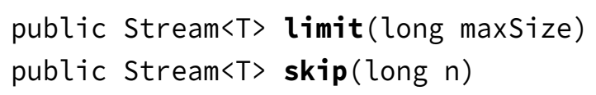
Chapter 10 – Streams
(code illustration snippet 34)
Removing Duplicates
- distinct() returns a ... that contains ...
(code illustration snippet 35)
Restricting by Position
- 2 methods skip() and limit() will ... and ...
(code illustration snippet 36)

Slide 22
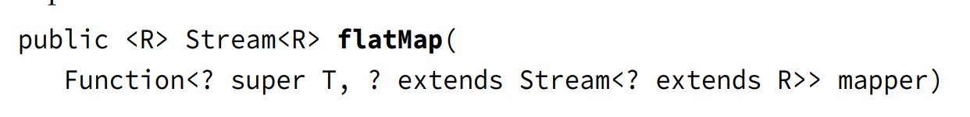
Chapter 10 – Streams
Mapping
- Method map() will create ... one-one ... between ...
(code illustration snippet 37)
Using flatMap
- flatMap() will simply ... each ... into ... and then the method will ...
(code illustration snippet 38)
- In general, ... is good, however if we just need to ... between 2 ..., we can use ... method
(code illustration snippet 39)

Slide 23
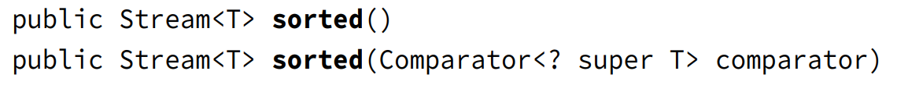
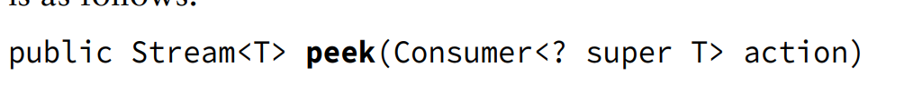
Chapter 10 – Streams
Sorting
- Method sorted() will return ... Java uses ... for sorting (explain again what is ...)
(code illustration snippet 40)
- Moreover, we can use ... for ...
(code illustration snippet 41)
- Explain why ...
(code illustration snippet 42)
Taking a peek
- This will be ... final ... we talking about
– Sometime, we want to do ... without changing ...

Slide 24
Chapter 10 – Streams
- Because peek() looks like ... => We can call it ...
- peek() is usually used to ...
(code illustration snippet 43)
Danger: Changing State with peek()
- peek() is used mainly to ... op without ... the ...
(code illustration snippet 44)
- However, Java doesn't ...
(code illustration snippet 45)
- This is a bad ... because ... changed ...
Putting together in a Pipeline
- Stream allows us to use method ... and express our ... instead of how ...
- For example, if we have a list of ... and we want to get ... with length = 3, we have to write like ...
(code illustration snippet 46)
- With Stream, we only ...
(code illustration snippet 47)
(code illustration snippet 48)

Slide 25
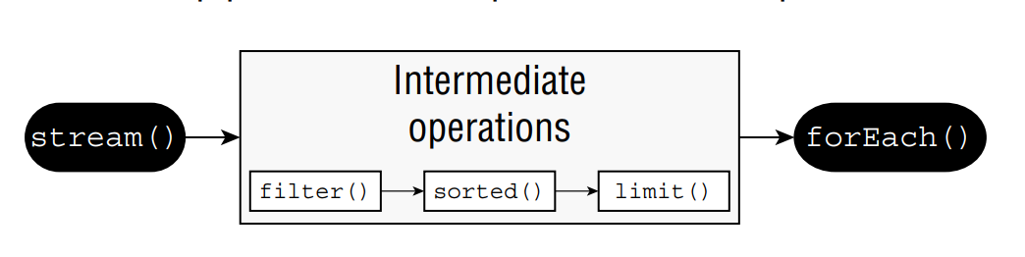
Chapter 10 – Streams
- Back to our old example about the ... line. Java as a .... This role has to ..., ..., and ... the workers...
- In this example, Java sees that ... limit() must ... Java when .... sorted() just ... when it has ... When sort() ... give it to ... for him to do it
– There are 4 elements, "Toby", "Anna", "Leroy", "Alex". Each of these will go through ..., if ... else ...
– Everytime ..., sorted() ...
– When sorted() ..., then it will ... limit()
- When limit() ..., it will forEach() ... => ...
(code illustration snippet 49, 50, 51, 52, 53)

Slide 26
Chapter 10 – Streams
Working with Primitive Stream
- Up until now, the Stream that we used are all same ... (..., ...) from ... Stream ...
– Even if we use ..., we will use generic ...
– However, Java did create some ... for ... type (..., ..., and ...)
(code illustration snippet 54, 55)
- This time we changed to ... from Stream... and the code will calculate the ...
– Stream... and ... has many ... op that looks ... however, ... have some ... that specialized in ...
- ... also have some auto... common ...
- Because Stream can only ... => Java included ... and ... for cal ...
(code illustration snippet 56)
Creating Primitive Streams:
...
...
...

Slide 27
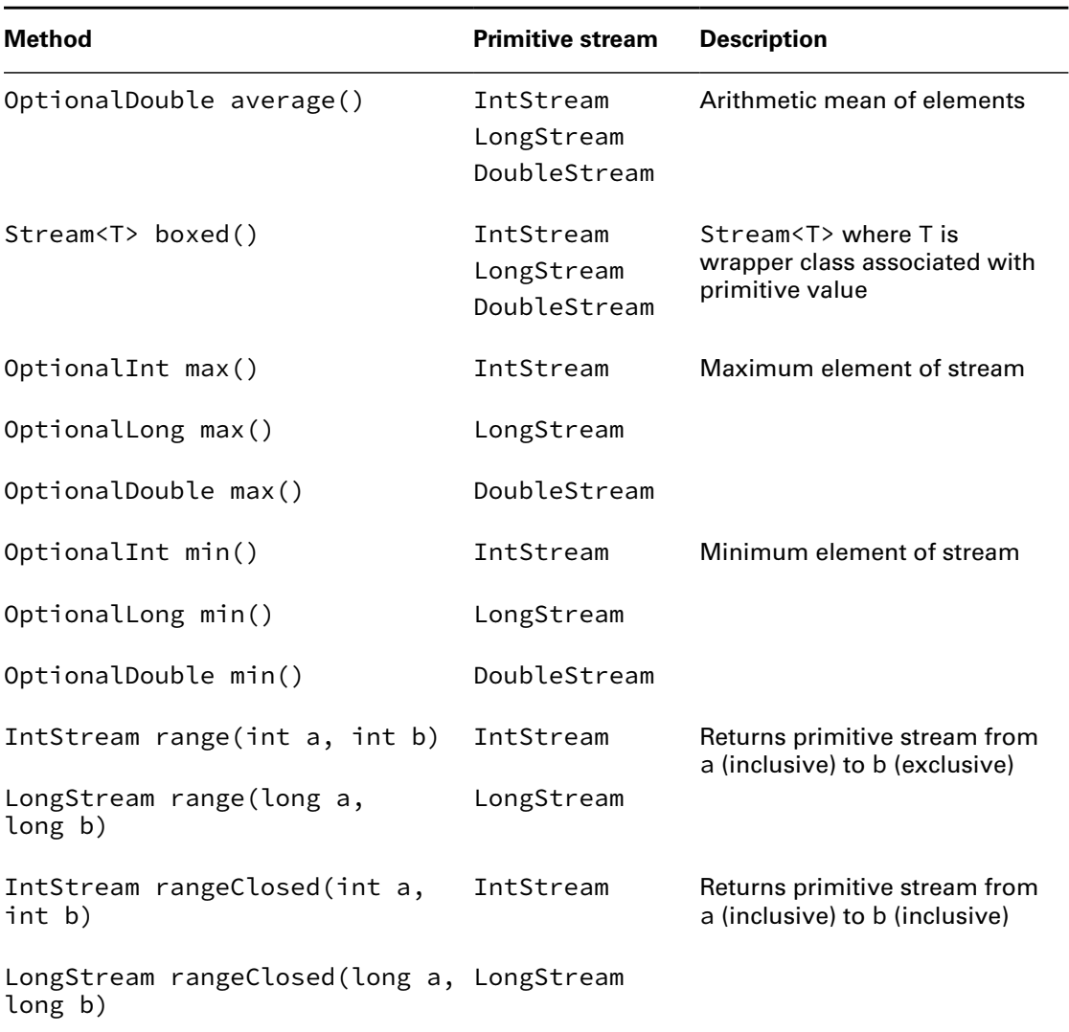
Chapter 10 – Streams

Slide 28
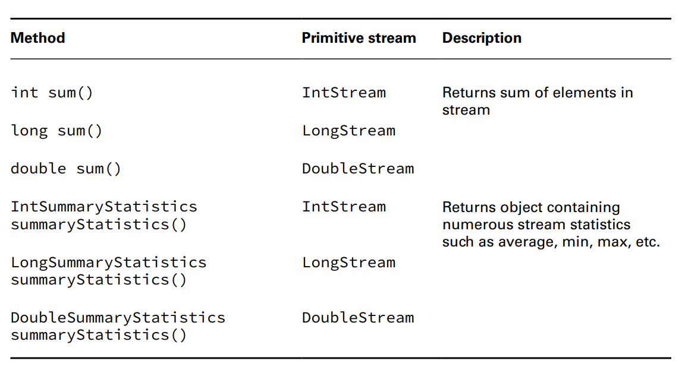
Chapter 10 – Streams

Slide 29
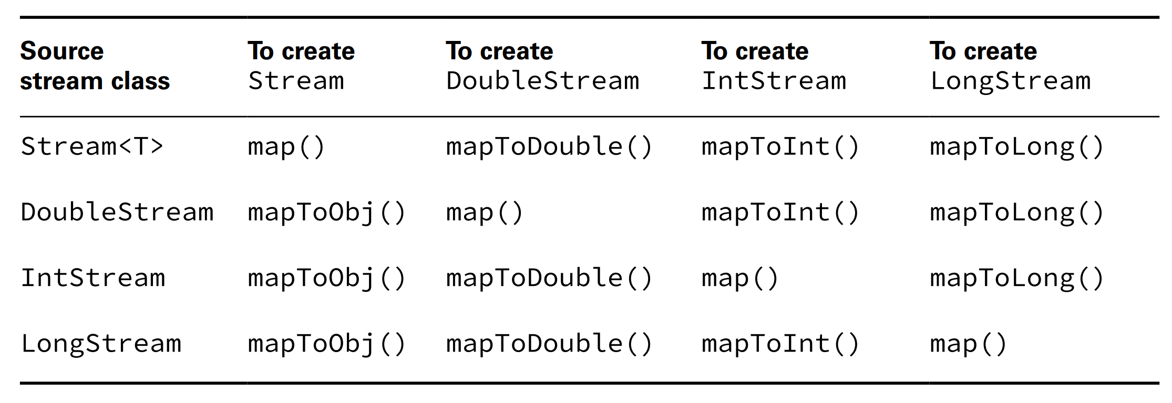
Chapter 10 – Streams
(code illustration snippet 57,58, 59, 60, 61, 62)
Mapping Stream

Slide 30
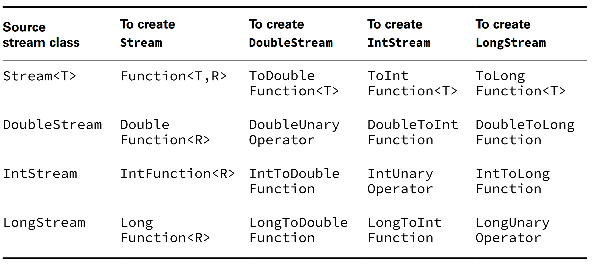
Chapter 10 – Streams
- Of course it must be ... so the convert ...
(code illustration snippet 63)
Using flatMap()
- Another way of ... (much more ...) is to use ...
(code illustration snippet 64)
- Back to mapping, this table is ...

Slide 31
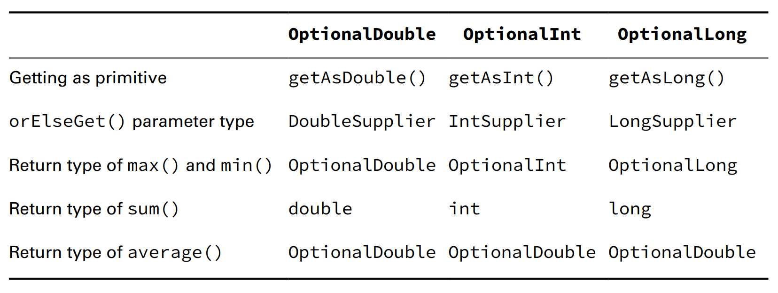
Chapter 10 – Streams
(code illustration snippet 65)
Using Optional with Primitive Streams
(code illustration snippet 66)
- But with ... stream, the return ... is not ... but it is ... Optional ...
- ... is different from ... regarding the ... type ...
– one is ... and one is ... However, both of them works ...
(code illustration snippet 67)

Slide 32
Chapter 10 – Streams
(code illustration snippet 68)
Summarizing statistics
(code illustration snippet 69)
- Now we use ...Stream and we want to find range by ... However, the problem is that both ... and ... is ... therefore we can't ...
– Java knows this and give us something called ...
(code illustration snippet 70)
- In ... class, we have the following method
getCount() (return ... = ?)
getAverage()
getSum()
getMin()/getMax()

Slide 33
Chapter 10 – Streams
Working with Advanced Stream Pipeline concept
Linking Streams to the Underlying Data
(code illustration snippet 71)
Chaining Optionals
- Other than the ... op that we know for ..., there are others ... for .... However, they aren't ... to Streams
- For example, if we want to check if the number has ... digits
(code illustration snippet 72)
- The code works but ...
(code illustration snippet 73,74)
- If we have another optional, then we ...

Slide 34
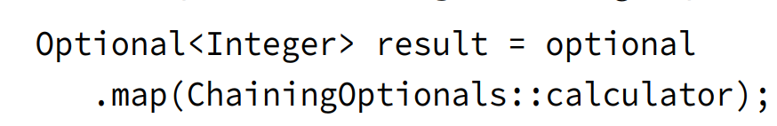
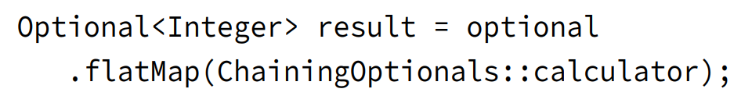
Chapter 10 – Streams
- What if we have a helper method that returns ...
- However, the problem is that ...
- To fix this, we have to use ...

Slide 35
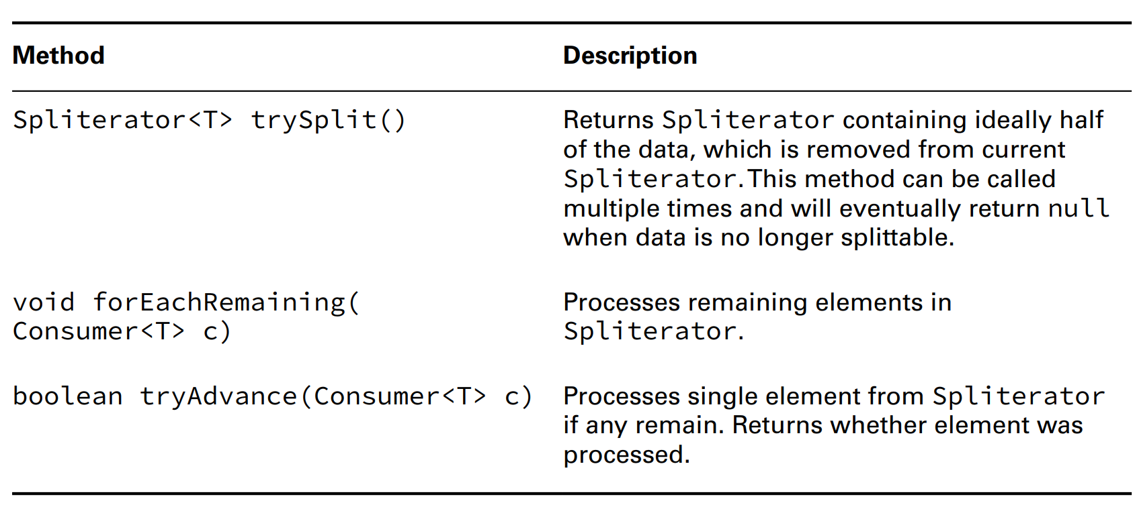
Chapter 10 – Streams
Checked execptions and Functional Interfaces
(code illustration snippet 75,76,77,78,79, 80)
Using a Spliterator
- Assume that you have a pack of ... for ...
- To prevent ..., you bring ... and ... into 2 ...
- Spliterator works ..., we start with a ..., if we call ... then the first ... will be in ... and the other ... will be in ...
- The characteristic of ... depends on ... If we use ... then the Spliterator would be ..., other wise it might be ... or ...
– The mechanic of Spilterators depends on something called ... (1 - ...) In the beginning, the position of ... will be ..., methods like ... or ... will ... the position of ...

Slide 36
Chapter 10 – Streams
(code illustration snippet 81)
- Now we will try with ...
(code illustration snippet 82)
- For ... stream, the method ... will take ... and not take ...
- Spilterator has many ...
+)
+)
+)
- However, in the exam, we only need to know ...

Slide 37
Chapter 10 – Streams
Collecting Results
- In the last part of Stream, we will talk about ... result. But first we will need to talk about some other ... methods in ... class
(These methods have been ... for simplicity ...)
- A special .... reduction(). This is used when all ...
Using Basic Collectors
joining()
(code illustration snippet 83)

Slide 38
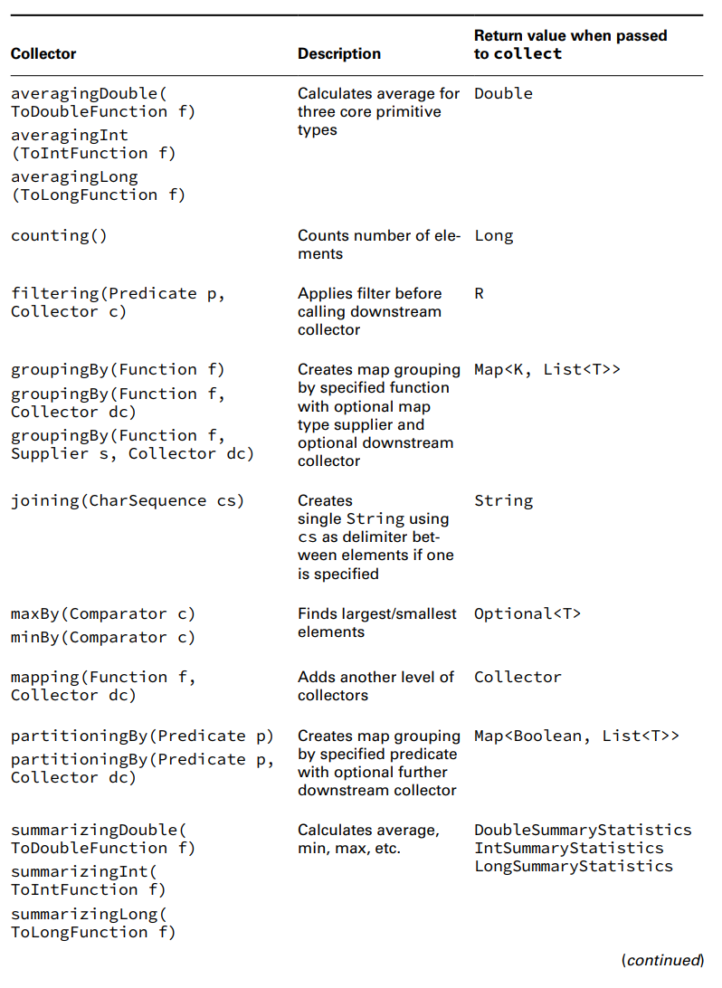
Chapter 10 – Streams

Slide 39
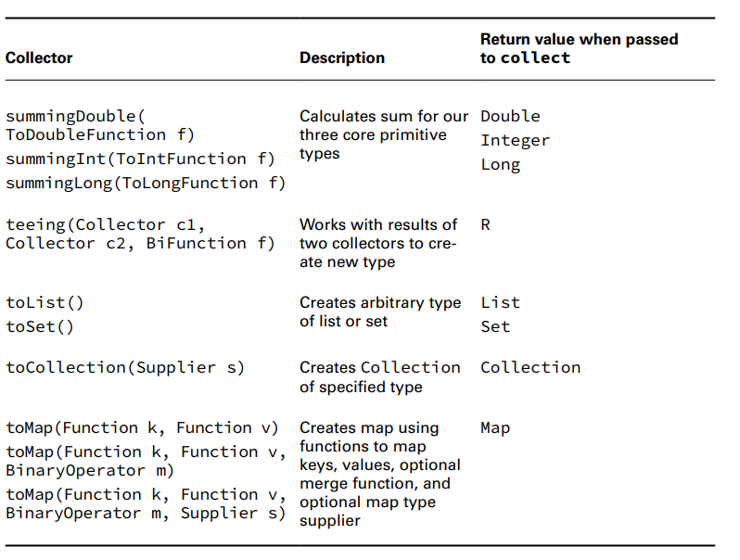
Chapter 10 – Streams

Slide 40
Chapter 10 – Streams
(code illustration snippet 84)
– Enterprise codebase doesn't usually use ... No problem, we can use ... and then ... back
(code illustration snippet 85)
Collecting into Maps
- Code that relates Collections with ... is usually more ... than ...
(code illustration snippet 86)
- Note: If we want to pass the same ... into ... , we can use Function... However, shorter doesn't mean ... so please ...
(code illustration snippet 87)

Slide 41
Chapter 10 – Streams
(code illustration snippet 88)
- Most of the time, the returned type of .... is ... However, this action is not ...
– We can certainly change this by ...
(code illustration snippet 89)
Grouping, Partitioning, and Mapping
- What if we want to ... element according ... length ...
(code illustration snippet 90)
- Note: The function that create ... must not ...because Java doesnt allow ...
- Also, if we don't want a ... to be returned ... we can ... use an optional ...
(code illustration snippet 91, 92)
- If we want to change .. but not the ... inside ...
(code illustration snippet 93)
- Partitioning is ... special ... of ... For partitioning, there are only 2 ... ... and ...
- Partitioning is the same as ...stream into ... pieces
- For example, we have 2 types of ... 1 is ... and 1 is ... => We can ... Stream base on this ...
(code illustration snippet 94,95)

Slide 42
Chapter 10 – Streams
- Note: In all ... partitioning always has ... ... and ...
(code illustration snippet 96)
- we can't change the type ... in ...
- Other than chaning the ... inside ... we can do other ...
(code illustration snippet 97)
Debugging Complicated Generics
- When we working with ..., we can see that there are ... layers of complicated ... => It can be too complicated that the ... error is unread...
- Here are some way to ...
+) Don't add all ... code ...
+) Separate ... statements ...
+) We can use ... generic to determine the ... if it compiles ... then ...
– Back to the ..., the final method ... mapping()
- mapping() adds another ...
(code illustration snippet 98,99)

Slide 43
Chapter 10 – Streams
Teeing Collectors
- What if we want to return ... at once ? This is a hard ... with Stream because we can't ... once it is ...
– SummaryStatistic is ... but not ... for us ...
– ... teeing() ... works for .. multiple ...
(code illustration snippet 100)
- This code uses ... collectors, ... for ... and ... for

